Slide 1
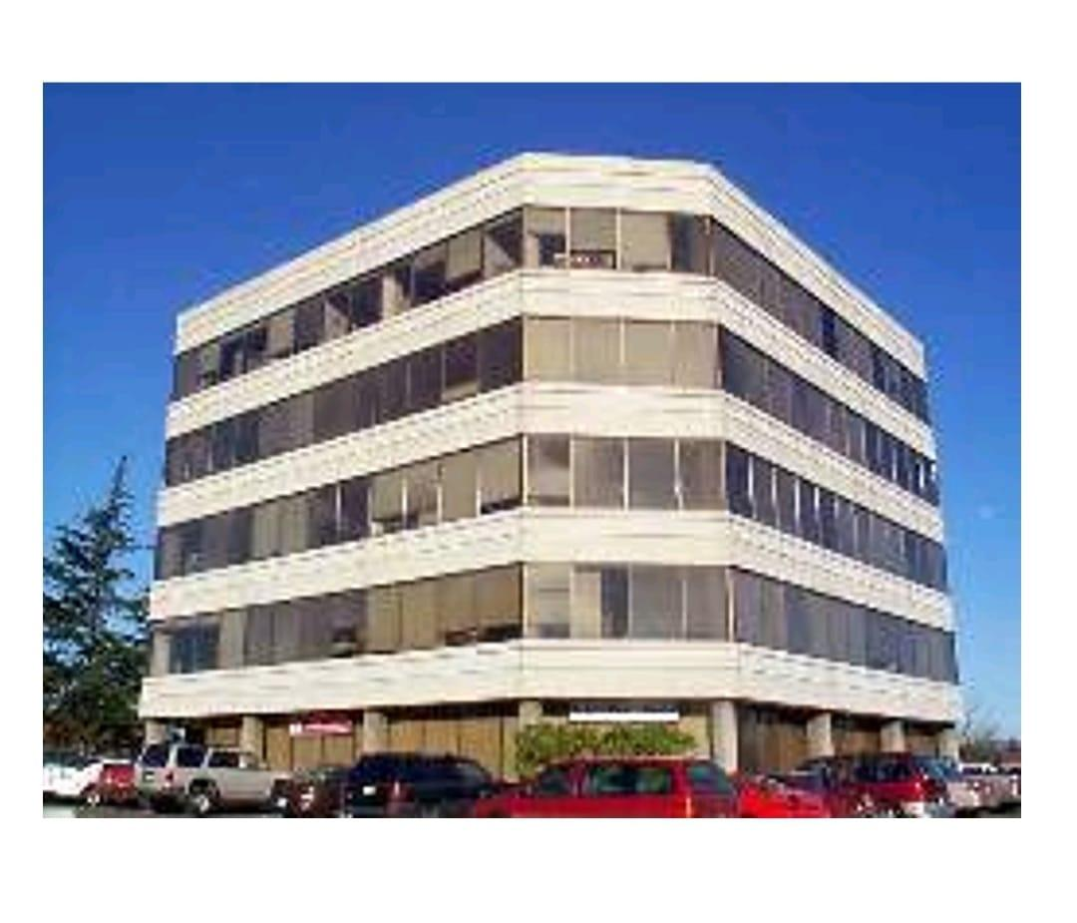
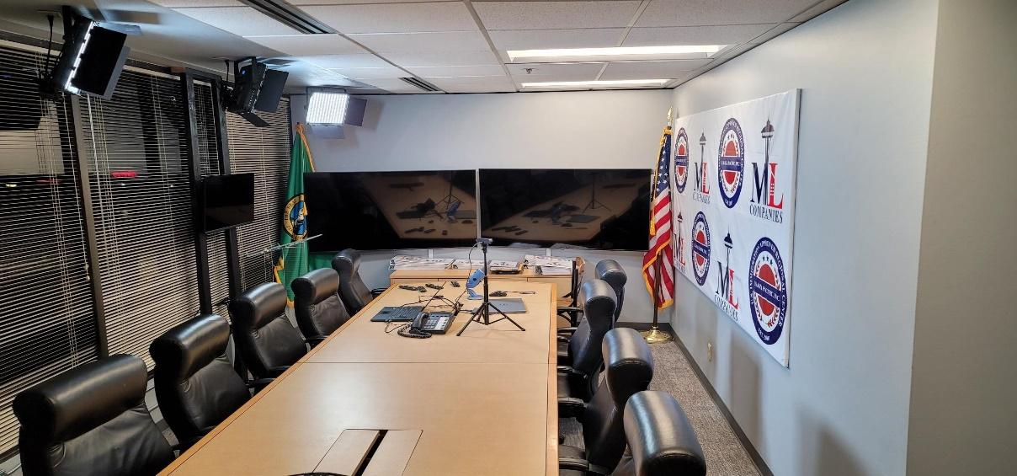
Real Estate Investment, Development, Funding,
Executive Training & Coaching Center.
Office: 206-322-DEAL(3325)
Direct: 206-310-DEAL(3325)
Email: DEAL@MLCompanies.co
https://www.mlcompanies.co/real-estate-continuing-education
16400 Southcenter Parkway Suite 206
Seattle, Washington 98188 USA.

Slide 2
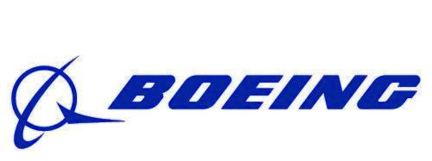
Home of Seattle Businesses

Slide 3
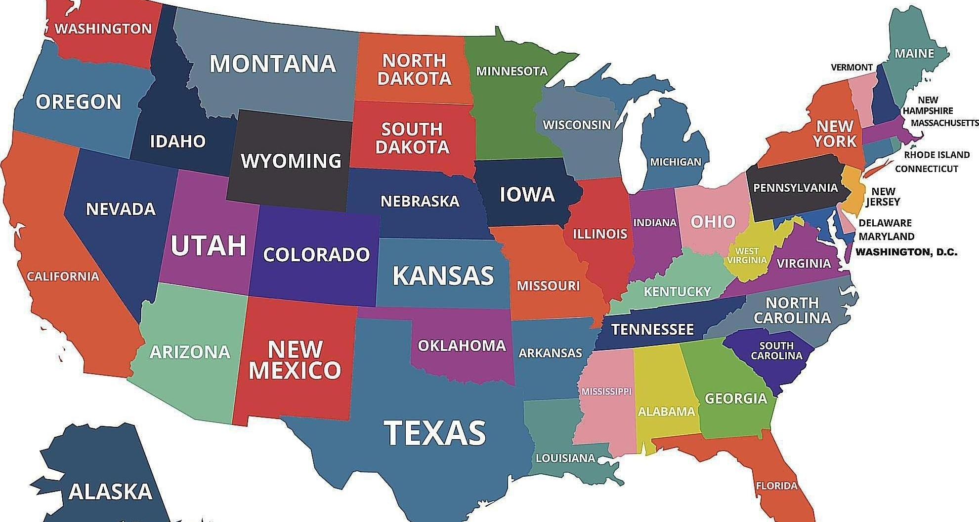

Slide 4
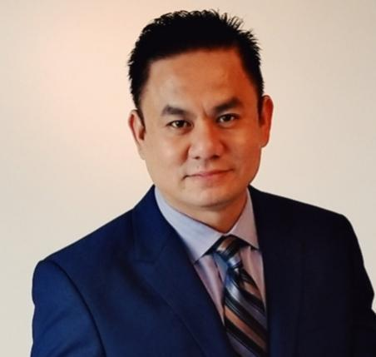
Management Team
Michael Lai | CEO | Investing Partner
Michael is a successful entrepreneur with 24 years experience and has completed over 3000 real estate transactions. He came to the United States in 1993 as a political refugee from South Vietnam.
Michael’s brokerage companies have completed $100,000,000 in annual sales volume. Annually since 1998 Michael’s development company, Seattle Modern Living (SML), currently has more than 4,000 residential units and 200,000 sq ft of retail space in pre-development or under construction. These assets include multi-family, residential, and retail developments. Upon completion, this real estate portfolio will be valued at over $ Two Billion USD.
Michael is an active member of the International Council of Shopping Centers (ICSC), Commercial Broker’s Association (CBA), Certified International Property Specialists (CIPS), Invest In The USA (IIUSA), and is an approved real estate educator in Washington State.
Michael has over 22 years of experience in the EB-5 industry. He was introduced to the EB-5 industry by helping regional centers with their funding and development. He has worked with EB-5 and Real Estate Development Industry to complete over 20 successful projects. Personally, Michael has brokered and assisted over 400 EB-5 Investors and their families to obtain permanent citizenship in the US through the EB-5 investment visa program.
Contact Info
ML Companies | Real Estate Investment, Development, Funding & Training.
USAsia Pacific Inc. | USCIS Approved Regional Center | EB-5 Investment
Office: 16400 Southcenter Parkway Suite 206 Seattle, Washington, USA 98188
Phone: 206.310.3310
Office: 425.241.1034
Email: michaellai@mlcompanies.co
WhatsApp: +12063103325
WECHAT: Michaellai2063103325
Website: MLCompanies.co/ usasiapacific.com/

Slide 5
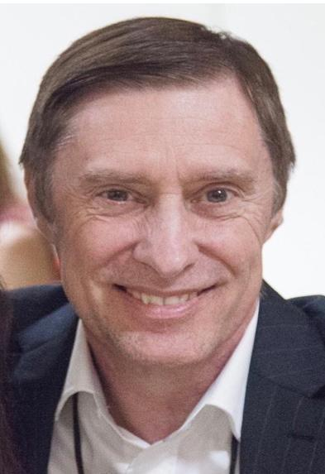
John Stiver | Vice President
John has over 25 years of experience in startups, management and raising funds. He has expertise in corporate structure including the use of stock to raise equity. He has raised over $10,000,000 and has launched several start-up companies including Advanced Biometrics, Inc. (ABI). At ABI, John patented Live Grip technology, and completed the successful acquisition of a titanium forming company. After winning several government contracts he turned the business over to a professional management team in 2001.
In 2019 John was introduced to Michael Lai. Now as Vice President of ML Companies John oversees acquisition negotiations, project management, and corporate accounting. John helped Michael create the ML Companies Funds to provide working capital and equity for development projects.
As Vice President of USASIA Pacific Inc., John is the head of investor relations, oversees corporate compliance, and works with the attorneys to ensure I-526 petition filings.
John has a passion for creating win-win situations between our clients and the communities that we live in.
Contact Infomation
ML Companies | Real Estate Investment, Development, Funding & Training
USAsia Pacific Inc. | USCIS Approved Regional Center | EB-5 Investment
Office: 1700 21st Avenue S, Suite 203 Seattle,Washington,USA 98144
Phone: 253.310.5468
Office: 425.241.1034
Email: john@mlcompanies.co
WhatsApp: +12533105468
WECHAT: Mithindril
Website: MLCompanies.co/ usasiapacific.com/

Slide 6
ML University
#1. MLU: 8Degree Camps Class
Held In the Seattle, Washington US. 2 Years Real Estate Program/ Real Estate Professional Live and Online & Training.
#2. MLU: 20 Advanced Business Workshop Courses Live & Online. (60Days of Group Training, Coaching to JumpStart Your Real Estate Investing Career).
#3. MLU Mortgage Home Page
https://learnmortgage.fastclass.com/af/MLCOMPFULL
#4. MLU Learn Mortgage Pre-license
https://learnmortgage.fastclass.com/af/MLCOMPPE

Slide 7
#5. MLU Mortgage CE Continuing Education
https://learnmortgage.fastclass.com/af/MLCOMPCE
#6. MLU Rockwell Institute (Washington State)
https://www.rockwellinstitute.com/WebSite/Register/Reg.asp?xid=CE7DB91C789D
#7. MLU Real Estate Express & McKissock Learning (All 50 United States/Pre-licensing & Continuing Education):
https://info.mckissock.com/mlcomp

Slide 8
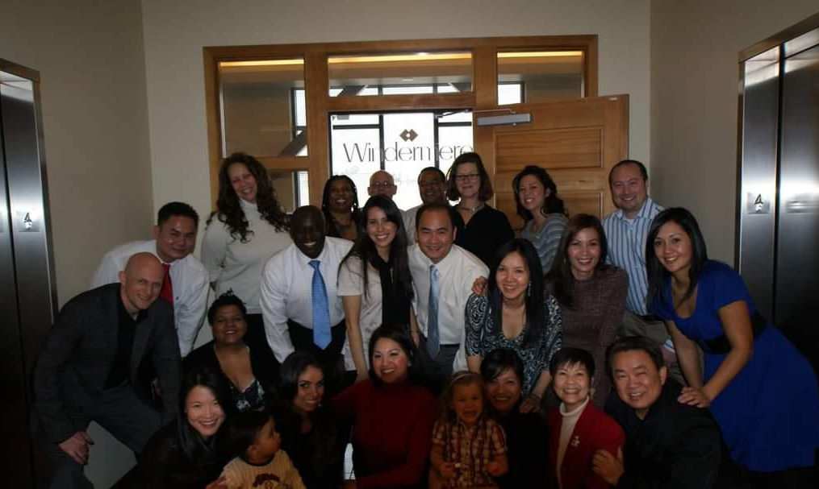
https://www.youtube.com/watch?v=9abMyIXCx_w&t=1s&ab_channel=MLCompanies

Slide 9
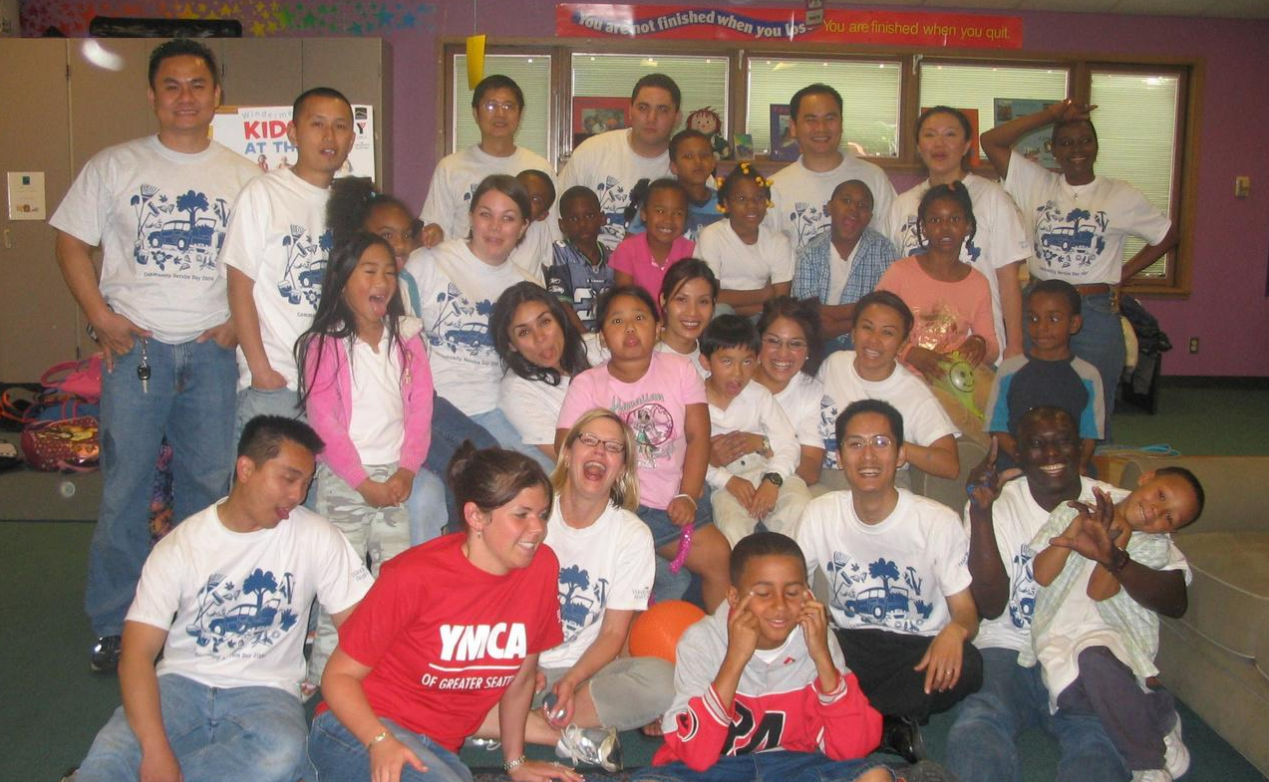

Slide 10
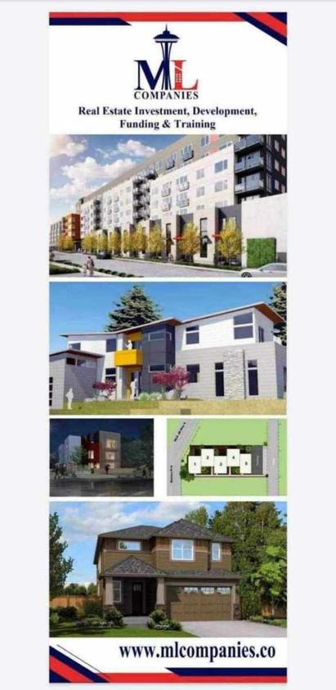
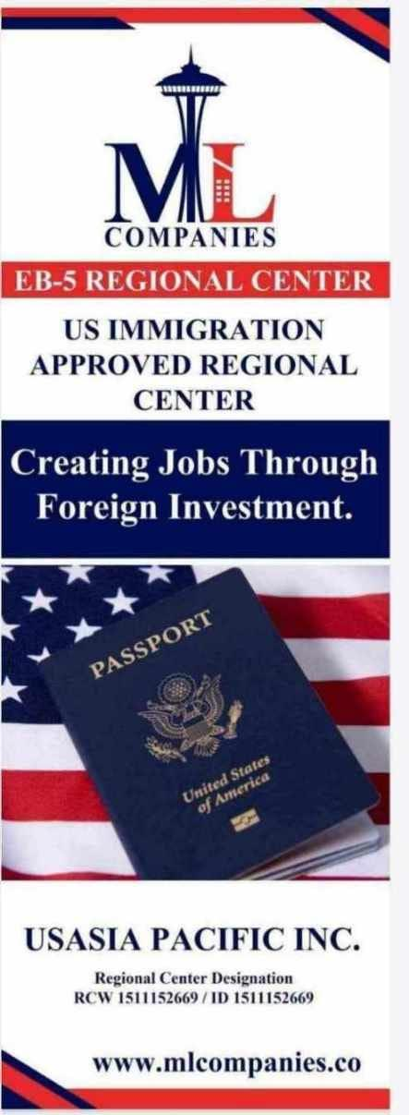
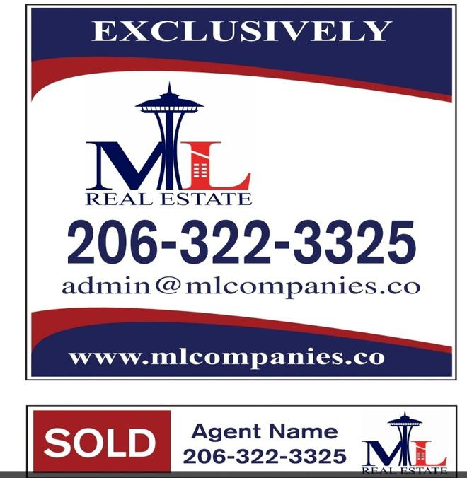
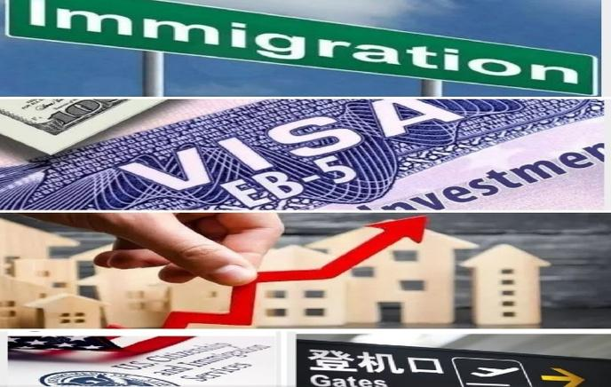

Slide 11
Michael Lai is a successful entrepreneur with 22 years experience over 3000 transactions in real estate service and sale companies.
Before starting ML Companies, a Real Estate Investment, Development and Management and USASIA Pacific Incorporated a United States federal approved regional center for immigration he spent ten years in the real estate investment brokerage and mortgage industry running real estate companies.
Since 2002 to 2012, the firms completed 100 million dollar assets annually, collectively more than one Billion Dollars in services and sale volume.
He is an active member of the ICSC International council of shopping centers, CBA commercial broker association, CIPS certify international property specialists, IIUSA Association to invest in USA and state of Washington approved real estate educator.
In addition, he has lectured and been a guest speaker at numerous industry conferences. Recently he also has created SML Seattle modern living communities an environmentally friendly, mixed-use multifamily portfolio of properties that includes over 8,000 residential units and 500,000 square feet of retail space.

Slide 12
REAL ESTATE ONLINES
GET REAL ESTATE LICENSED
Take online self-paced courses
Earn your pre-licensing requirements at your own pace, on your own time.
Livestream your courses online and in real time
Complete pre-licensing courses, live and in real time, from any device. Led by instructors in a classroom setting, enjoy it all from the comfort and safety of home.
Complete your CE
Our CE courses are more than a state requirement. Local experts from the industry also help you take your business to the next level.
Become a broker
Elevate your career (and earning potential) by becoming a licensed broker.

Slide 13
Real Estate
Leading real estate schools empower aspiring and seasoned real estate professionals to start or advance their career through unmatched learning solutions.​​​​​​​​​​​​​​
Our programs build blueprints for a real estate professional’s career by preparing them for licensing exams, helping to maintain licensure, and providing tools and resources to inspire growth.

Slide 14
Financial Services
Financial Services is a recognized leader in licensing for the securities, banking, wealth management, and insurance sectors, providing education that furnishes high pass rates, student-instructor communication, and an intuitive learning platform to house it all.

Slide 15
Teacher Education
Through our online teacher certification prep program with Teach-Now, we help educators around the world become thoughtful, resourceful problem solvers.

Slide 16
Healthcare
Healthcare prepares students and professionals for challenges and changes in the industry with convenient learning solutions to help them deliver better care.
Our leading schools guide nurse practitioners to pass their licensing exam and offer continuing education and professional development opportunities across several healthcare fields.

Slide 17
Evaluation & Property
For over 20 + years, we’ve provided leading property Appraisal Education for every stage of an appraiser’s career, including appraisal licensing courses, continuing education, and professional development.
Accounting
As a global leader in Certified Public Accountant (CPA) exam prep, premier accounting educator, Becker, offers market-leading products in continuing education and in Certified Management Accountant (CMA) test prep. For more than 60 years, Becker has helped professionals achieve their CPA licensure and advance their careers. The company has worked with partners in nearly 40 countries, including the top 100 accounting firms in the U.S.

Slide 18
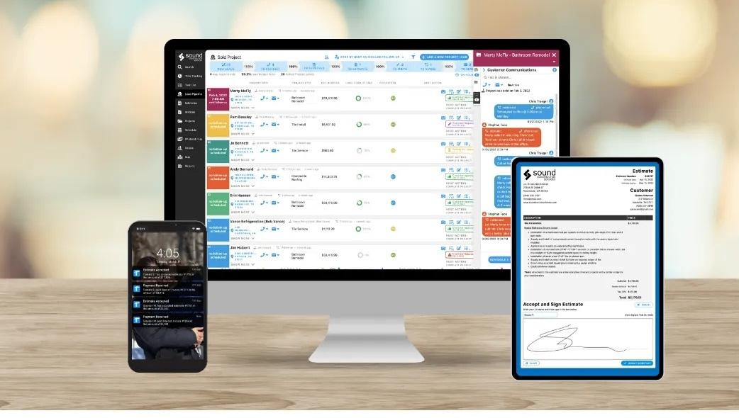
Mortgage
Mortgage
Career Hub
Learn Mortgage: Allied's Top Partner in Mortgage Education
Allied Schools and Learn Mortgage joined forces to bring you the very best in mortgage education.
Whether you're just getting started in your mortgage career, need exam prep or are looking for continuing education, Learn Mortgage has options.

Slide 19
MLC HEADQUARTER
16400 Southcenter Parkway Suite 206
SEATTLE, WASHINGTON 98188 USA.
MLCompanies.co I 206.322.DEAL I DEAL@MLCompanies.co
Training & Coaching for
Real Estate, Financial Professional
Executive Management Training
Real Estate Developers, Investors.
including Q & A, and a live role-play designed to dramatically increase your new real estate business to take you to the next level.
Program is consisting of Power-Packed.

Slide 20
THE NEXT LEVEL
OF REAL ESTATE EDUCATION, TRAINING & COACHING.
https://www.youtube.com/watch?v=HS7pZ6z6C7w&t=353s&ab_channel=MLCompanies

Slide 21
Advance Business Workshop
Program is a 3 months program consisting of 20 Power-Packed,
Live lecture,
including Q & A, and a live role-play designed to dramatically increase your new real estate business to take you to the next level.
https://www.youtube.com/watch?v=HS7pZ6z6C7w&t=155s&ab_channel=MLCompanies

Slide 22
1. Time Management
https://www.youtube.com/watch?v=BehyKsFF9j8&t=17s&ab_channel=MLCompanies
2. Prospecting
https://www.youtube.com/watch?v=8GqMMEzwErU&t=213s&ab_channel=MLCompanies
3. Past Clients and Center of Influence
https://www.youtube.com/watch?v=1NfAv6uBl8o&t=215s&ab_channel=MLCompanies
4. Pre-Qualifying
https://www.youtube.com/watch?v=QK5wv0pQ5O8&t=5s&ab_channel=MLCompanies
5. Lead Follow-Up
https://www.youtube.com/watch?v=CDneRIG8HjY&ab_channel=MLCompanies
6. Listing Presentation
https://www.youtube.com/watch?v=3McM6kMThV4&ab_channel=MLCompanies
7. Pricing Property
https://www.youtube.com/watch?v=YRaiAsnOvu0&t=182s&ab_channel=MLCompanies
What you will learn

Slide 23
8. Handling Objections
https://www.youtube.com/watch?v=qg_AH3gXMPc&t=998s&ab_channel=MLCompanies
9. Closing Skills
10. Negotiating
11. Working with buyers
https://www.youtube.com/watch?v=Jmzb9_94_rI&t=103s&ab_channel=MLCompanies
12. Administration and Staffing
13. Customer Service
https://www.youtube.com/watch?v=g20Nrp97d6c&t=43s&ab_channel=MLCompanies
14. Business Planning
https://www.youtube.com/watch?v=ln2F01oAB5o&ab_channel=MLCompanies
Advance Business Workshop

Slide 24
15. Tracking numbers
16. Practicing Scripts and Developing Skills
17. Understanding Personality Styles
https://www.youtube.com/watch?v=zB9i7PBAATE&t=52s&ab_channel=MLCompanies
18. Mindset
https://www.youtube.com/watch?v=2JLK7WWyLtw&t=209s&ab_channel=MLCompanies
19. Goal Setting and Motivation
20. Money Management and Profitability
https://www.youtube.com/watch?v=8LE9B5goAEM&t=667s&ab_channel=MLCompanies

Slide 25
ABW Advanced Business Workshop EVENTS Calendar of 2022
ML university
16400 SOUTHCENTER PARKWAY SUITE 206
SEATTLE, WASHINGTON 98188
TEL: 206.322.DEAL I DIRECT 206.310.DEAL I EMAIL: DEAL@MLCOMPANIES.CO I WEB: MLCOMPANIES.CO

Slide 26
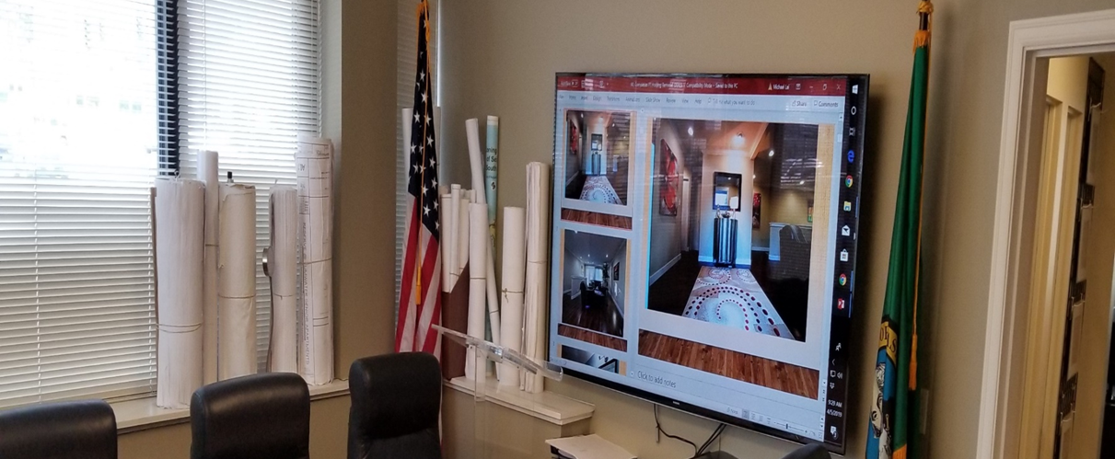
Approved Continuing Education with
Real Estate Education Program
Washington State Department of Licensing
ABW Advanced Business Workshop
VISIT: MLCompanies.co

Slide 27
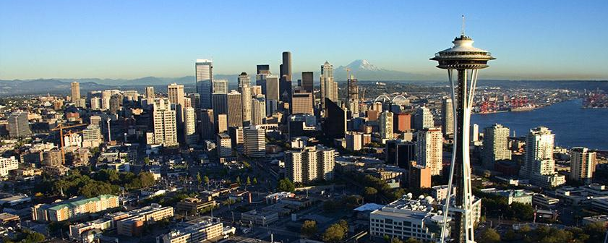
Commercial Real Estate offers a variety of investment opportunities. After this advanced training you will be equipped to recognize the exciting potential.
For beginners, Commercial Real Estate may provide quick cash for debt relief through wholesaling.
More experienced investors will want to hold for cash flow and appreciation to improve their lifestyle.
During this training, you will explore the Real Estate Cycle with open discussions on trigger points, cycle length, and reading your market. You will also gain a thorough understanding of the four basics types of commercial property: retail, warehouse, office and multi-unit residential (apartments)
Investor’s Success Agenda

Slide 28
ML Degree Camp Guarantee and Details
Degree Camps come with a "life change guarantee "If you can look me in the eye at the end of the camp and say that your life wasn't changed, I will give you your money back!
Full price for one, half price for significant other, relative or verifiable partner.
You get two years to complete the program.
We do seller financing. We have wonderful terms set up and ready to go.
You must pay for each camp in full before you attend.
Sign up for one camp and I promise to change your life!
1.Degree Camps
Pricing for New Students/2 Years Program.
1 Camp ............. $3,995
​3 Camps ............ $9,995
​8 ​Camps ............ $​23,995
2. Real Estate Training/Coaching.
$1,000 Per Month/2 Years Commitment.
Visit MLCompanies.co for a full calendar of upcoming Degree Camps and ABW events.

Slide 29
ML INVESTORS SUCCESS AGENDAS
https://www.youtube.com/watch?v=I5zCGB_jWSg&t=116s&ab_channel=MLCompanies

Slide 30
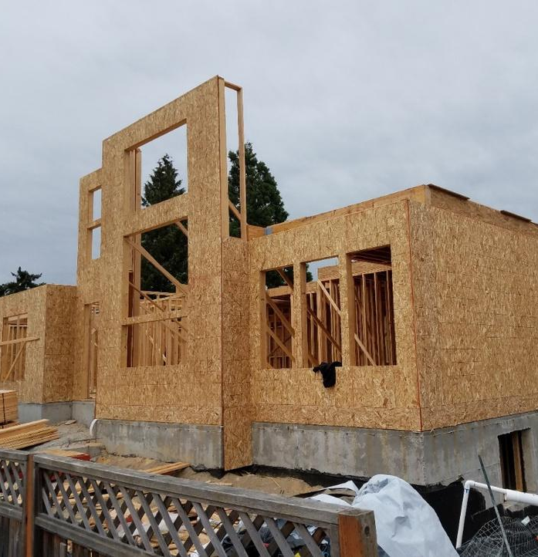
ML Real Estate Developer/ Degree Camp
Learn how to become a Real Estate Developer https://www.youtube.com/watch?v=YXGamkkBvO4&t=926s&ab_channel=MLCompanies

Slide 31
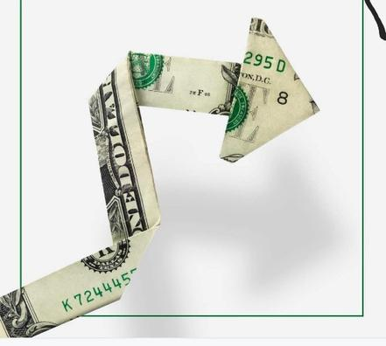
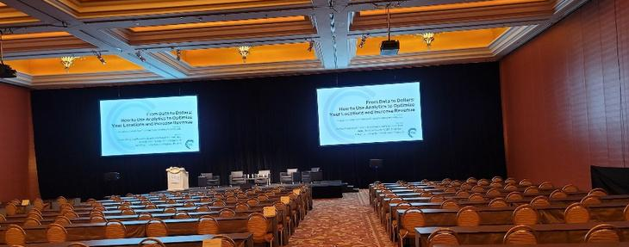
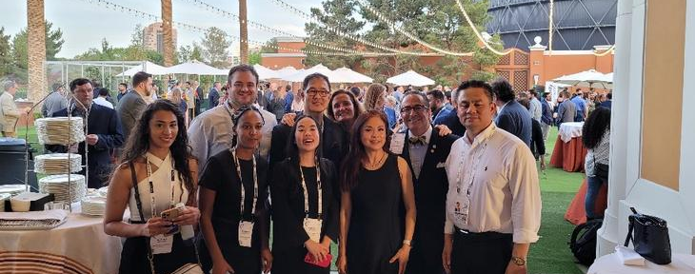
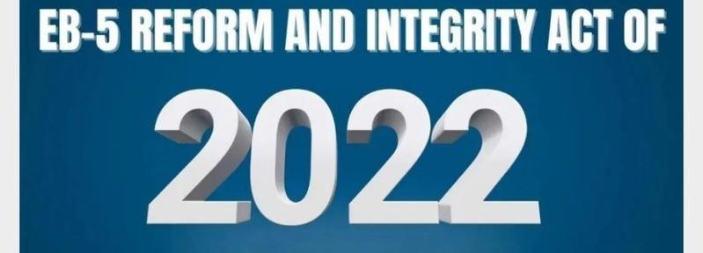
EB5 New Reform and Integrity Act of 2022

Slide 32
Meet ML, Modern Living EB-5 Team In-Person
at USASIA EB-5 Green Card Investment Seminars
Time: April 28ᵗʰ 2022 at 9AM
Location: New World Saigon Hotel
76 Le Lai Street. District 1. Saigon. Vietnam SE Asia.
Miami, Florida, Las Vegas, Seattle, San Diego, Brazil, Mexico, Columbia, Paris, France, London, UK, Saigon, Ha noi, Da nang, VN, Hongkong, Taiwan, Macau, Beijing, Shanghai, China
Registration is Free, but space is limited.
https://www.eventbrite.com/e/315592484617
View available USASIA Fund 18 / The Hiltons Hotels,
San Diego, California, USA
https://www.youtube.com/watch?v=Lq8XedqsbmI&t=2s&ab_channel=MLCompanies
https://www.mlcompanies.co/theinns/
Click here to message Us on WhatsApp to Arrange a Personal Meeting.

Slide 33
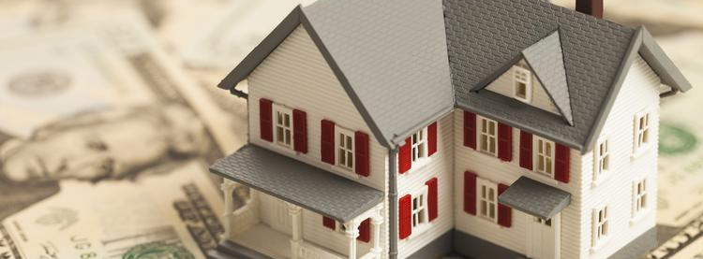
At ML Modern Living Companies, we served more than 3,000 EB-5 families from over 75 countries s in Real Estate, Loans, Relocation and Immigration services to the USA since 1998.
Join us for these events to find out how you can get New USA Home, Loan & Green Cards for yourself and your family through the EB-5 visa program with an $800K investment.
Our US training team has extensive experience in business strategy, investment evaluation, and securities, tax, and immigration law.

Slide 34
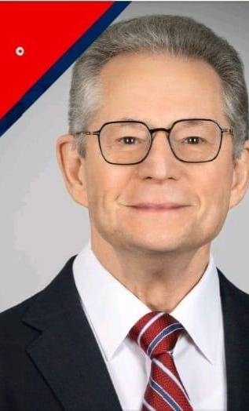
Training Topic for USASIA EB-5
Real Estate Immigrant Investors. LP Limited Partners.
Q&A; Who Should Attend this USASIA EB5 Green cards Training?
Foreign Immigrant Investors Who Interested in Obtaining USA Residency Through Real Estate Investment in the US.
What will you learn;
Why and What City, State in the USA should me and my family relocate to ?
How long will my investment money be invested?
What is ROI (Return of Investment) of my Money in the US Real Estate Market.
How long until me and my family receive a USA Green Card and US Citizenship?
How are EB-5 Real Estate Investment projects structured?
How to select a potential Project Developer/Owner, Development Team, Builder Team, Financing Team, Legal and Immigration Attorney Team to work for you?
What are the basic ABC steps of the EB-5 process?
What are the benefits of EB-5 investment vs. Other type of USA Visa?
What ato have USA Green cards.

Slide 35
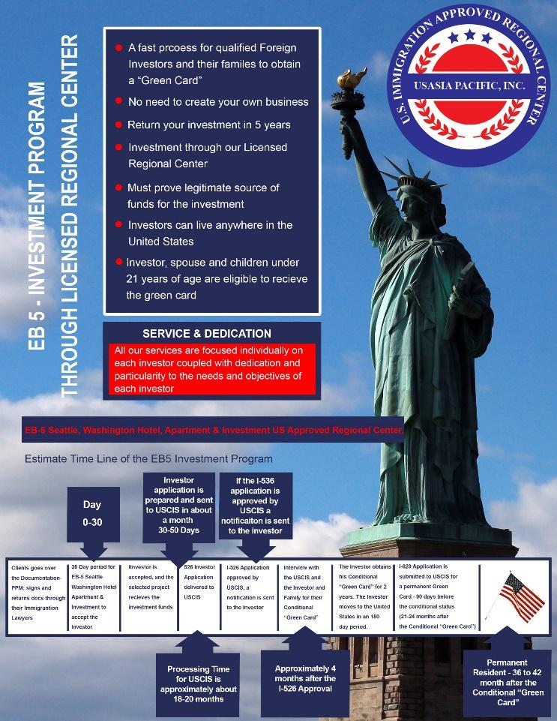
Timeline of USASIA EB5 Fund Investment Program / Degree Camp

Slide 36
ESTIMATE TIMELINE OF THE EB5 INVESTMENT PROGRAM

Slide 37
EB-5 Real Estate Investment /
Degree Camp.
Video:
https://www.youtube.com/watch?v=yLt-HzhjZPc&t=310s&ab_channel=MLCompanies

Slide 38
What are the steps for an EB-5 investor to obtain a green card?
How many EB-5 investors is my project eligible for?
When can my project begin to accept EB-5 investment capital?
What is an EB-5 Regional Center and why do I need one?
Does my project site qualify as a TEA ($800K investment)?
How will I market my EB-5 project to potential EB-5 investors?
USASIAPACIFIC.COM

Slide 39
How to structure EB-5
Real Estate Investment Deal
What type of structures are most common in EB-5 projects?
How much flexibility is there in the structure of an EB-5 project?
Where does EB-5 fit into the capital stack?
Does EB-5 structure vary by project type and investor market approach?

Slide 40
How to Market an EB-5 Project
How to design an EB-5 project to appeal to different markets?
https://www.youtube.com/watch?v=cG0vdvwRUyE&ab_channel=MLCompanies
What are the most effective approaches to marketing an EB-5 project?
Which EB-5 markets are growing and which are shrinking?
What can a Project Sponsor do to maximize the chance of success in EB-5 marketing?

Slide 41
https://www.youtube.com/watch?v=-0dcm9XCd48&t=278s&ab_channel=MLCompanies

Slide 42
Contracts / Degree Camp
Learn how to think contract as a weapon
How to negotiate term for profit
Understand all type of terms and when to use them.
How to make money on contracts.
How to write multiple contract on everything you buy.
How to buy for lower price than the contract states
Negotiate through due diligence and inspection.
How to negotiate everything in a contract.

Slide 43
Real Estate Investment Deal Evaluation
Here is what you will learn at this camp:
How to see the whole investment pictures.
Learn the different investment components of transactions.
Evaluate the Short-Terms Profit.
Evaluate for Long-Terms Cashflow and Equity positions.
See the pitfalls before they happen. Learn how to buy properties with confident.
Create a powerful evaluation packets to raise capital and get bank financing
Buy good Deal and avoid bad Deals.

Slide 44
Raising Capital/Degree Camp
Create higher returns for Investors , leveraged by real estate
Overcome fear that investors have
Learn how to give fantastic presentations with documentation.
Understand SEC concerns and how to legally raise capital.
Become cash buyer with no cash.
Overcome banking industry problems with massive equity position
Learn trust deeds, promissory notes, interest rate and return matrixes.

Slide 45
B​us Tour / Degree Camp
​• See 25+ of Mike's personal investing deals.
• See small, medium and large deals at once.
• See every technique Mike teaches in the flesh
• Leave with over 2 5+ templates for deal success.
• See neighborhoods, property and zoning in a new light.
• Take the fear out of investing by seeing it done
• Learn to apply these techniques in your marketplace.
• See ​the Result of ABW ​"Highest and Best Use" in action.

Slide 46
Learn 20+ strategies to make properties worth more than you find them
Learn pre-ownership Flips or Assignments
Multiple strategies on flipping
Learn income, square footage, units, terms, advertising, physical condition fixer-uppers
Learn Flixers (Doing some of the work and making most of the profits)
Creating and Enhancing Equity / Degree Camp
https://www.youtube.com/watch?v=PfkML2OF70A&t=27s&ab_channel=MLCompanies

Slide 47
Create a repeatable income that never ends
• Positive cash flows in properties
• Create property-less passive income
• Learn how to turn equity into cash flow
​Cash Flow / Degree Camp​
Create interest-only notes that never pay off
• Learn how to set up incredible financing for better cash flows
• Learn strategies to get tenants to pay higher rents

Slide 48
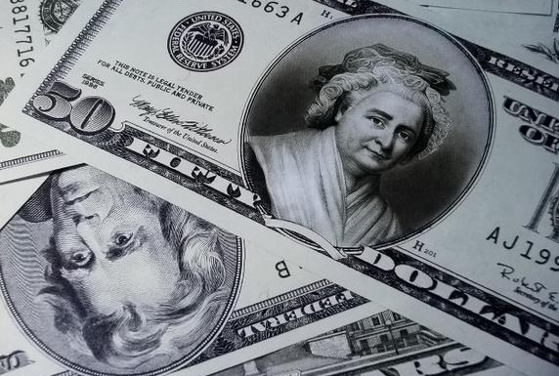
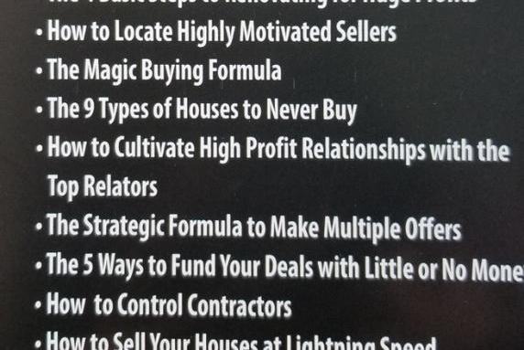
Re-Development.
Renovating Properties for Massive Profit.

Slide 49
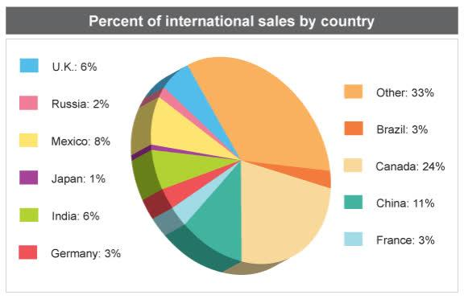
Foreign Buyer / Investors
Real Estate Diversity
Real Estate International Deals
Helping Foreign Buyers/ Investors to buy in the US
Video:
https://www.youtube.com/watch?v=oVhX3Z8R-bI&ab_channel=MLCompanies

Slide 51
Commercial Real Estate Learning Objectives
Understanding the real estate cycle
Once you are empowered with a fundamental understating of commercial real estate, we will work on your personal presentations for attracting deals and financing.
The final steps of the training will be to discuss the paperwork needed to secure an investment and review existing leases for due diligence.

Slide 52
Commercial Real Estate
Learning Objectives
Understanding the real estate cycle
Evaluating Area Comps
Harnessing the deal
Exploring creative deal structures
Understanding lease terms & their impact on due diligence
Mastering the basics of retail, warehouse, office, & apartments
Once you are empowered with a fundamental understating of commercial real estate, we will work on your personal presentations for attracting deals and financing. The final steps of the training will be to discuss the paperwork needed to secure an investment and review existing leases for due diligence.
Cashflow, & Analyze & understand investment calculations including cash flow, gross rent multiplier, net operating income (NOI), cap rate, cash on urn on investment (ROI)
Raising capital
Building your network
Securing your financing
Negotiating the deal

Slide 53
Seller Financing/ Degree Camps
Reasons that serious investors must be at this class:
Learn how to get financing without going to the banks.
Be able to offer mortgages to people who can’t get them.
Use seller financing as a capital raising tool.
Learn simple assumptions.
Learn how to buy and sell LLC instead of properties.
Build up residual income and positive cash flow.
Property-less passive income.
Recyclable mortgages.
Learn how to deco lateralize buildings with seller financing on them.

Slide 54
Seller Financing: Reasons that serious investors must be at this class: https://www.youtube.com/watch?v=KC9_R89a4as&ab_channel=MLCompanies
1. Learn how to finance anything.
You will turn any kind of sale into a seller financing deal
2. Converting lease options into seller financing
Making down payments commercial/conventional with no money down
Understanding tax implications
3. Incorporating 1031’s and seller financing in the same deal
Paying a mortgage off quickly by wrapping
4. Reviewing assumption addendums and novation agreements Buying down interest rates,
5. Creating seller financing partnerships
Trust deed and notes Escrow companies, Value of title Insurance Issues, FHA/government loans
6. Contract language and disclosure, Calls/balloons Pre-payment Penalties and bonuses
Interest only vs. principal payments

Slide 55
Land Development
Degree Camp
https://www.youtube.com/watch?v=RXm8gspWA-Q&t=54s&ab_channel=MLCompanies
Land Investment can cover everything from several hundreds acres to owning a single vacant lot. It represents the ultimate accomplishment for a real estate investor. The profit potential is impressive and it gives you the opportunity to have a permanent, positive effect on community.
This ultimate advanced training will provide you with variety of strategies you can use to control and develop real estate. You'll walk through the development process in a step-by-step fashion. You'll discover how to buy ahead of growth, improve zoning to increase value, as well as how to build or sell to another investor. Along the way, you’ll also explore the details of platting to obtain appreciation. In addition, you will learn how to finance your deals through banks, seller participation and private investors.

Slide 56
Learning Objectives
Explore the many ways land can be used:
1. Understand the elements of highest & best use
Discover the Seven Key Strategies for Land Development
Know the questions to ask the owner or realtor before you buy
Identify what to look for while walking the subject site
2. Discuss how to improve zoning
Understand how to plat or subdivide
3. Discuss environmental issues & how they impact a development
Become familiar with Phase 1 & 2 Environmental Site Assessments (ESAs)
Know what mitigation is & how it affects the development process
4. Identify the details & purpose of an offering memorandum
Explore Return on Investment (ROI)
Locating & dealing with banks

Slide 57
https://www.youtube.com/watch?v=Lq8XedqsbmI&t=3s&ab_channel=MLCompanies
Discuss Regulation
Discover how to offset the carrying costs associated with holding land
Learn how to find potential deals
Identify & recruit the Power Team members involved land development
This training is presented by a licensed, third-party Land Development Group.

Slide 58
Kubota Garden 1
https://www.youtube.com/watch?v=-dY2XsbhprQ&ab_channel=MLCompanies

Slide 59
Training Example.

Slide 60
COMPLETE PROJECT DOCUMENTATION

Slide 61
6 WEEKS TO ASSEMBLE A COMPLETE SET OF EB-5 PROJECT DOCUMENTS

Slide 62
EB 5 – INVESTMENT PROGRAM
THROUGH LICENSED REGIONAL CENTER
SERVICE & DEDICATION

Slide 63
ESTIMATE TIME LINE OF THE EB5 INVESTMENT PROGRAM

Slide 64
EB-5 REGIONAL CENTER AFFILIATION in 21 States
MLU REAL ESTATE LICENSED Training in 50 States
Real Estate Licensed in 50 States

